Slide 1

Luk 395 dia Clutch failures

Slide 2
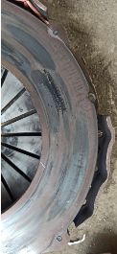
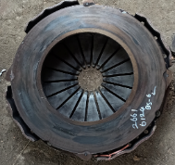
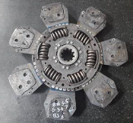
Luk 395 Clutch burnt
Complaint / Problem details |  | Luk 395 dia clutch burnt |  |  |  | Issue status
 |  |  |  |  |  | Issue grade
Model |  | 3525/2825/4825 T, 5525/5425/5225 TT, 4825 H, 2825 6X4 H | Failure KM | Avg 1570 hours/ 62K km |  | Data period | BS6 till Feb’23
Mfg plant |  | H2 & PNR | No of cases | 7849
Observation/ Root cause | Burnt marks found in pressure plate/ disc. Thermal cracks found in pressure plate No abnormalities found in pressure plate material. Clamp load in failed cover assy conforms to spec No clutch actuation related issues observed in 73% of clutch burnt failures Field study carried out in Flyash application – wheel slip/ wheel lock found in loading point Failure not specific to any km/ hour range Competition bench mark reveals, 430 clutch usage in majority of 250 HP models. |  | Photos / Illustration |  | Illustration
Action | ER-DIN-0094731 dated 28-Feb-2023 released for Luk 395 dia clutch with 8 pad, high clamp load cover assembly & 4 inch clutch booster in place of current 7 pad Design. T: Jul’23 ER-DIN-0095078 dated 16-Mar-2023 released for Setco 395 (8 pad rigid back plate design) for 250 HP Tippers alternate to Luk 395 dia clutch. H2 cut-off: 26-Jun-23, PNR: from next production Spec release planned for 430 dia Clutch in Tippers. T: Aug’23 (A4) & Sep’23 (H6 4V) Engine-GB coupling fixture planned for assembly. T: Jul’23 Clutch handling process/packaging improvement planned at Supplier end. T: Jul’23 Application related (Overload/ clutch riding/ wrong gear usage) issues taken up with Service for action
RL3
4
Thermal cracks & burnt marks
Without actuation related issues
Burnt marks

Slide 3
Model wise Warranty cost
Data as on Feb’23
Luk330
Luk395
Setco 380
395 & 380 dia clutch: WCPV high in 6X4, 8X4 & 10X4 Tippers
330 dia clutch: Warranty cost high in Ecomet 1615 haulage

Slide 4
Model wise Incidences
Luk330
Luk395
Setco 380
395 & 380 dia clutch: Failure rate high in 6X4, 8X4 & 10X4 Tippers
330 dia clutch: Failure incidence high in Ecomet 1615 haulage

Slide 5
Luk 395 Clutch burnt
Failure Km & Hour range wise
Data as on Feb’23
80% beyond 500 hours
76% beyond 20K km
80% of failures > 500 hours & 76% are >20K km of operation

Slide 6
Luk 395 Clutch burnt
Cause & Effect Diagram
Design
Manufacturing
Material
Clutch insufficient friction surface
Cover assy riding on FW spigot
Cover assembly clamp load
Disc cushion deflection
Pressure plate material
Sequence tightening not followed in CA fitment
Disc cushion segment hardness
Pressure plate hardness
Cushioned ceramic disc performance sustenance not effective
Disc cushion segment material
Jerky fitment of GB with Engine
Disc clamped thickness
Pressure plate lift
Clutch capacity not sufficient
Fulcrum ring position
Clutch burnt/ slippage/ thermal crack
Wring program selection in EOL machine
Disc storage
Leak in clutch hydraulic PTFC joint
Overload in application
EOL testing machine calibration
Seal swell in clutch master cylinder
Wheel spinning
Calibration frequency not adhered
Supplier process
Clutch actuation
Application

Slide 7
Luk 395 Clutch burnt
Cause verification
S.No | Category | Cause | Observation | Significance
1 | Material | Cover assembly clamp load | Verified in failed part & found ok | No
2 |  | Pressure plate material | Verified in failed part & found ok | No
3 |  | Pressure plate hardness | Verified in failed part & found ok | No
4 |  | Pressure plate lift | Verified in failed part & found ok | No
5 |  | Disc cushion deflection | Verified in failed part & found ok | No
6 |  | Disc cushion segment hardness | Verified in failed part & found ok | No
7 |  | Disc cushion segment material | Verified in failed part & found ok | No
8 |  | Disc clamped thickness | Verified in failed part & found ok | No
9 |  | Fulcrum ring position | Verified in failed part & found ok | No
10 | Assembly | Cover assy riding on FW spigot (Luk 395) | CA riding on spigot observed in few cases during 2021 | Yes
11 |  | Sequence tightening not followed in CA fitment | Inconsistency in adherence to sequence tightening | Yes
12 |  | Jerky fitment of GB with Engine | During Process study at H2, 3 out of 16 assembly found with jerky fitment | Yes
13 | Design | Clutch insufficient friction surface | Friction surface not sufficient for higher HP (Engine power)/ Torque & higher tonnage applications. And clutch heat FOS not meeting the requirement in overload condition | Yes
14 |  | Cushioned ceramic disc performance sustenance not effective | Cushion segment deformation/ bend observed due to thermal load | Yes

Slide 8
Luk 395 Clutch burnt
Cause verification
S.No | Category | Cause | Observation | Significance
15 | Design | Inadequate clutch size | FOS in FGR not meeting the requirement (Luk 395) in overload condition. Also Bench marking study reveals usage of 430 dia clutch in majority of 250 HP Tippers in Competition vehicles | Yes
16 | Supplier process | EOL testing machine calibration | During process audit, calibration issue observed in machine | Yes
17 |  | Wring program selection in EOL machine | Found ok | No
18 |  | Calibration frequency not adhered | Earlier calibration record verified and found ok | No
19 | Clutch actuation | Leak in clutch hydraulic PTFC joint (380& 395) | Clutch actuation failures observed due to PTFC joints leak during 2021. Corrective action taken for the same. However 71% of clutch burnt cases are without clutch actuation related attention | Yes
20 |  | Seal swell in clutch master cylinder (380&395) | Clutch actuation failures observed due Master cylinder seal swell observed during 2021. Corrective action taken for the same. However 71% of clutch burnt cases are without clutch actuation related attention | Yes
21 | Application | Overload in application | Field study / I alert study carried out and overload/ wheel spin/ clutch riding observed | Yes
22 |  | Wheel spinning | Field study / I alert study carried out and frequent wheel spin/ clutch riding observed | Yes
23 |  | Clutch burnt cases are not to be entertained under warranty as per Policy | Clutch burnt cases are being booked under standard warranty. Competition bench marking reveals no warranty is being given for burnt cases | Yes

Slide 9
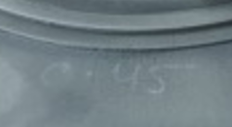
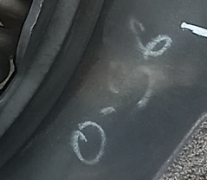
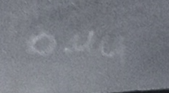
Setco 395 dia clutch failures – Retro fitted
 | Case 1 | Case 2 | Case 3 | Case 4 | Case 5
Veh Reg. number | AP39 UL 3516 |  |  | AP39 UJ 5499 | AP39 UK 7629
Chassis number | MB1JJVLD5NRPE3726 | MB1XEVLD4PRNF6978 | MB1H3LHD7PPJW9333 | MB1JJLHD4NRDB3606 | MB1JJLHD3NRDB6691
Engine number | NPEZ703918 | PNEZ700342 | PJPZ121204 | NDHZ425523 | NDHZ426943
Engine Type | A4 | A4 | H6-4V | H6-4V | H6-4V
CBN number | CTN352522B0005 | CTN482529B0005 | CTU282516B0002 | CTU352522B0007 | CTU352522B0007
DOS | 06-Jan-23 | 31-Mar-23 | 26-Jun-23 | 30-Sep-22 | 18-Nov-22
Date of Setco clutch fitment | 25-Jun-23 | 19-Jun-23 | 26-Jun-23 | 24-Jun-23 | 29-Jun-23
Hours - Setco clutch fitment | 1537 | 427 | Setco fitted before delivery | 2843 | 2124
DOF (Setco clutch) | 29-Jun-23 | 29-Jun-23 | 29-Jun-23 | 03-Jul-23 | 04-Jul-23
Failure Hours (Setco clutch) | 1588 | 488 | 39 | 2963 | 2168
Hours covered by Setco clutch | 51 | 61 |  | 120 | 44
Location | AMPL - Kakinada | AMPL - Vijayawada | Jai Ambay Automobiles-Kangra | AMPL-Kakinada | AMPL - Srikakulam
Disc S.No. |  |  | 146 | 186 - Mfg month: K-05/23 | 356 - Mfg month: K-05/23
Disc spin free value identification in disc |  |  | 0.45 | 0.36 | 0.44
Cover assy S.No. |  |  |  | 397 - Mfg month: K05/23 | 238 - Mfg month: K05/23
Flywheel Part number & Make | B3F15002 (Manthri metallics) | B3F15002 |  |  | B3F16003 (Padmavati castings)
Application | Boulders / Blue Metal / Crusher Dust | Sand (River bed) | Sand | Sand (River bed)/ Blue metal/ Red soil | Sand (River bed)
Operating route | Mulagapudi (Rowthalapudi) to Uppada | River bed to stock yard |  | Sand - Bullanka to Kakinada surounding Blue metal - Rowthalpudi to Yanam Red soil - Sourampalam to Kakinada surounding | Sand transportation to various part locations

Slide 10
Setco 395 dia clutch failures – Retro fitted
 | Case 1 | Case 2 | Case 3 | Case 4 | Case 5
Observation | Heat marks found. Ceramic material fused on PP & FW face | Heat marks found. Ceramic material fused on PP & FW face Contact found in outer side alone (Ceramic pad mid to OD) | Heat marks found. Ceramic material fused on PP & FW face Contact found in outer side alone (Ceramic pad mid to OD) | Heat marks found. Ceramic material fused on PP & FW face | Heat marks found. Ceramic material fused on PP & FW face
Drive voice | In laden condition, after ~2.5 km from loadong point, vehicle jerked. Then gears were not engaging | In laden condition, after 100 m from loading point, vehicle was moved side for giving way to opposite vehicle. During the time vehicle stuck in mud. Then the vehicle moved in reverse and while moving forward gears not engaging | Gear not engaging | After loading at loading point, Gears were not engaging. Vehicle unloaded there itself and driver moved the vehicle from loading site with help of JCB, then vehicle started by releasing clutch and moved to Workshop by driving (60Kms). (Gear used C,3,5 &7). | : After loading sand at river bed, gears not engaging. Then unloaded, gears engaged in ignition OFF condition and moved the vehicle till workshop(10kms)
1st clutch failure in the vehicle
Hours | 987 | 240 | 39 | 1545 | 1528
DOF | 11-Apr-23 | 22-May-23 | 29-Jun-23 | 05-May-23 | 10-May-23
Parts replaced | Clutch disc, cover, Flywheel, FW pilot brg & CRB | Clutch disc, cover & Flywheel |  | CA & FW replaced | CA replaced & FW facing done
2nd clutch failure in the vehicle
Hours | 1045 | 425 |  | 1850 | 1754
DOF | 17-Apr-23 | 19-Jun-23 |  | 13-May-23 | 29-May-23
Hours covered by the replaced parts | 58 | 185 |  | 305 | 226
Parts replaced | Clutch disc, cover & Flywheel | Setco kit & Flywheel |  | CD, CA & FW replaced | Clutch disc, cover, Flywheel, FW pilot brg & CRB
3rd clutch failure in the vehicle
Hours | 1537 | 488 |  | 2843 | 2124
DOF | 24-Jun-23 | 30-Jun-23 |  | 24-Jun-23 | 29-Jun-23
Hours covered by the replaced parts | 492 | 63 |  | 993 | 370
Parts replaced | Setco kit & Flywheel | New Setco kit, Flywheel & FW pilot brg |  | Setco kit & FW replaced | Setco kit, FW & FW pilot brg
4th clutch failure in the vehicle
Hours | 1588 |  |  | 2963 | 2168
DOF | 03-Jul-23 |  |  | 03-Jul-23 | 04-Jul-23
Hours covered by the replaced parts | 51 |  |  | 120 | 44
Parts replaced | New Setco kit & Flywheel |  |  | New Setco kit replaced | New Setco kit replaced

Slide 11
Setco 395 dia clutch failures – Retro fitted
Case 1 Cover assy & Flywheel under analysis at MED and Thermal study on Clutch disc under progress by PD
Failed parts of Case 4 & 5 in transit to Setco. JI planned on 11th Jul 2023

Slide 12
Setco 395 dia clutch failures – Failed parts analysis
Cover assembly
 |  | Case 4 | Case 5
Cover assy number |  | 397 | 238
Clamp load | 21000 N min | 22816 N | 22235 N
Release load | 6450 N max | 5996 N | 5969 N
Pressure plate lift | 1.70 mm min | 2.04 mm | 2.08 mm
Pressure plate lift parallelism | 0.3 mm max | 0.15 mm | 0.27 mm
Cover assy setting height (FW face to diaphragm finger) | 59-63 mm | 60.61 mm | 60.54 mm
Date of mfg |  | 27-May-2023 A shift | 29-May-2023 B shift
In mfg, 6 nos. per shift is being inspected for above parameters. Inspection register on the date of mfg of above covers verified and found as per spec (Approx ~80 will be produced per shift)
Clutch disc
 |  | Case 4 | Case 5
Clutch dis number |  | 186 | 356
Face out on ceramic pad | 0.8 mm max | Ceramic pad melted & damaged | Ceramic pad melted & damaged
Ceramic parallelism | 0.2 mm max | Inspection under progress | Inspection under progress
Run out of back plate OD | 1 mm max | 0.39 mm | 0.45 mm
Spline size | As per gauge | OK | OK
Spin free |  | Inspection under progress | Inspection under progress

Slide 13
Setco 395 dia clutch failures – Fresh parts inspection
Pressure plate
 |  | Sample 1 | Sample 2 | Sample 3 | Sample 4 | Sample 5
Conicity | Flatness 0.15-0.25 mm Not convex | 0.2, 0.2, 0.21, 0.23 | 0.19, 0.19, 0.21, 0.20 | 0.20, 0.20, 0.20, 0.20 | 0.20, 0.20,0.20,0.20 | 0.18, 0.19, 0.18, 0.18
Waviness on pressure plate face outer side | Not called in drawing * | 0.03 mm | 0.03 mm | 0.03 mm | 0.02 mm | 0.05 mm
Waviness on pressure plate face inner side | Not called in drawing * | 0.02 mm | 0.03 mm | 0.03 mm | 0.01 mm | 0.02 mm
* Checked by placing the pressure plate on surface table & measurement taken on face with dial
The above pressure plates assembled. The same parameters under inspection at assembly level.
Then after spigot machining, same inspection planned

Slide 14
Setco 395 dia clutch failures – Fresh parts inspection
Pressure plate conicity checked in 5 nos. and found within spec
Clutch disc 25 nos. (10 nos. from current production, 2 nos. from April batch and remaining from Jun’23 production) checked and observed face out less than 0.8 mm (spec: 0.8 mm) and the same checked in spin free found within 0.5 mm (Spec 1.25 mm)
1 complete disc assembly from child part level (back plate & ceramic pad) made in AL Team presence and verified for spin free – Observed 0.32 mm
Clutch disc purposefully bent to 1.45 mm & and verified for spin free – Observed 1.1 mm which was passed in spin free machine. Hence Setco agreed to pass spin free upto 0.55 mm

Slide 15
Thank You

Slide 16
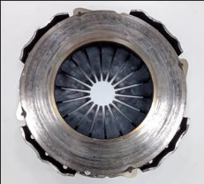
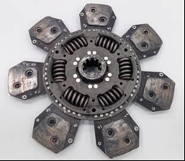
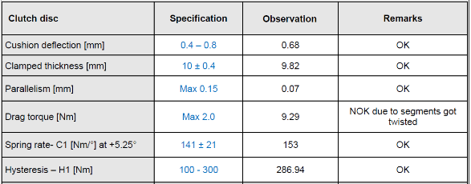
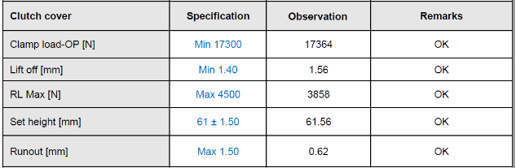
Cause verification – Material
Failed part analysis - Case 1
Claim | 27765304
Chassis | MB1H3VLD3NREA4541
Veh model | N2825T A 9SZF L3R3 M1 SBG ELC 14RBT
DOS | 12-Sep-2022
DOF | 21-Nov-2022
Failed hours | 317
Dealer | Durga Motors Company - Hassan
Clutch cover assembly & disc observed burnt / Thermal crack observed on the pressure plate friction surface
No actuation related issues noticed in this vehicle
Cushion segment found deformed. Hardness & material conforms to spec
Clutch disc functional parameters – No abnormalities found
Clutch cover functional parameters – No abnormalities found

Slide 17
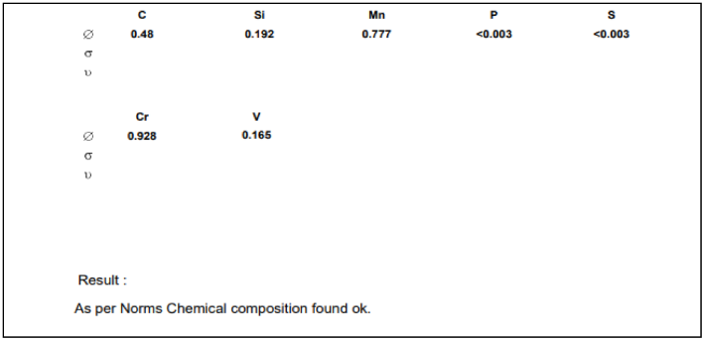
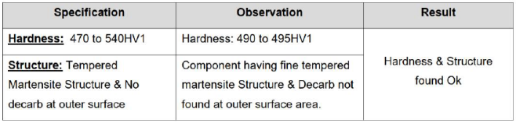
Cause verification – Material
Failed part analysis - Case 1
Cushion segment material – Conforms to spec
Claim | 27765304
Chassis | MB1H3VLD3NREA4541
Veh model | N2825T A 9SZF L3R3 M1 SBG ELC 14RBT
DOS | 12-Sep-2022
DOF | 21-Nov-2022
Failed hours | 317
Dealer | Durga Motors Company - Hassan
Cushion segment hardness – Conforms to spec

Slide 18
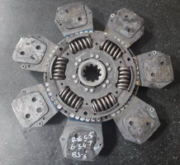
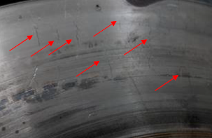
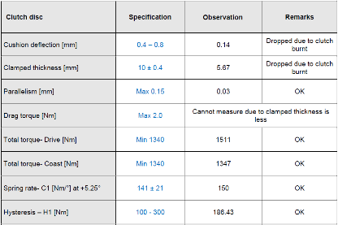
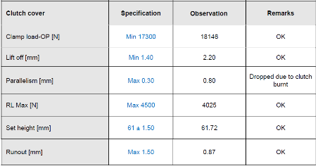
Cause verification – Material
Failed part analysis - Case 2
Claim | 26566347
Chassis | MB1XEVLD1MREP5312
Veh model | N4825 10X4 DTLA Tipper
DOS | 30-Sep-21
DOF | 28-Dec-21
Failed hours | 811 hours
Dealer | Shree Automotive-Md Bazaar
Clutch cover assembly observed with burnt condition/ Thermal crack observed on the pressure plate friction surface
Clutch disc burnt
No actuation related issues noticed in this vehicle
Clutch disc burnt
Burn marks/ Thermal cracks in Pressure plate
Clutch disc functional parameters – No abnormalities found
Clutch cover functional parameters – No abnormalities found

Slide 19
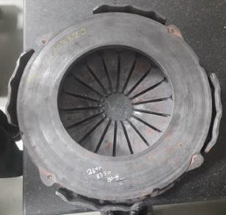
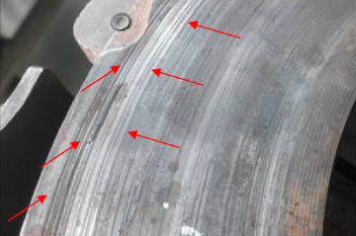
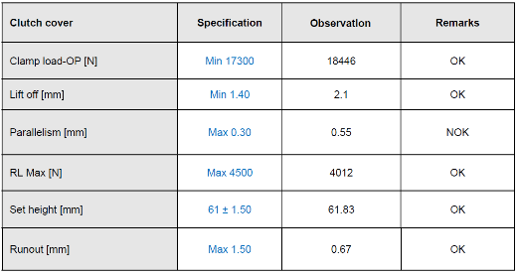
Cause verification – Material
Failed part analysis - Case 3
Claim | 26703320
Chassis | MB1JJVLD3MRBS3446
Veh model | N3525 Tipper
DOS | 04-Jan-22
DOF | 06-Feb-22
Failed hours | 159 hours
Dealer | TVS - Perambulur
Clutch cover assembly observed with burnt condition/ Thermal crack observed on the pressure plate friction surface
No actuation related issues noticed in this vehicle
Burn marks in Pressure plate
Clutch cover functional parameters – No abnormalities found
Due to burnt

Slide 20
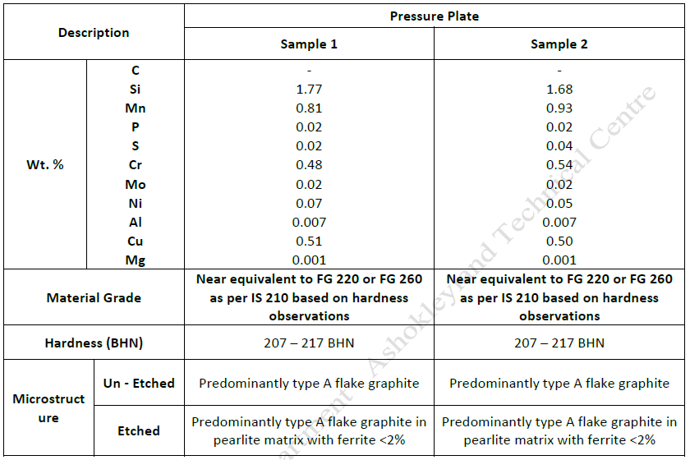
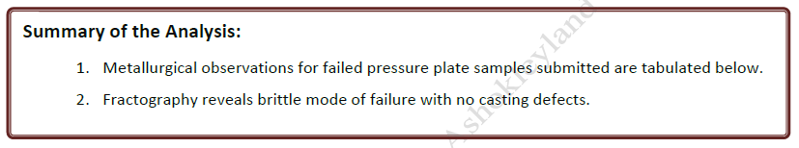
Cause verification – Material
Failed part analysis - MED analysis

Slide 21
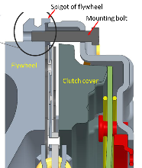
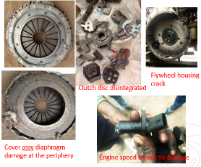
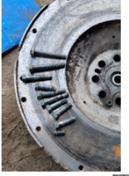
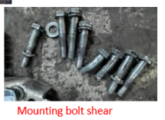
Cause verification - Assembly
395 dia clutch assembly mounting bolt breakage/ Flywheel spigot breakage
Complaint / Problem details |  | 395 dia clutch assembly mounting bolt breakage/ flywheel spigot breakage consequentially leading to damage in flywheel housing and other related parts |  |  |  | Issue status | RL5
 |  |  |  |  |  | Issue grade | 4
Model |  | Models with A4 engines (250hp) | Failure KM |  | 800 Kms – 60000 Kms
Mfg plant |  | H2/ PNR
Observation/ Root cause | Vehicle reported for the complaint of noise from gearbox side, observed flywheel housing broken/ clutch cover mounting bolts broken/ flywheel spigot broken/ clutch disc disintegrated Based on the preliminary analysis of the failed parts, observed flywheel spigot breakage lead to consequential damage on clutch assembly & other parts Flywheel spigot breakage is due to improper seating of clutch cover over flywheel (Flywheel spigot digging marks observed on the clutch cover) |  | Photos / Illustration | Illustration
 |  |  |  | v
Action | Following actions were taken to improve the clutch assembly process Guide pins to centralize the cover assembly inline with flywheel axis. C: Jul’21 Two point mounting lifting tackle to lift the cover assembly. H2 & PNR: Jun’21, Ennore & Alwar: May’23 ER-DIN-0081379 released for modified flywheel with 1 mm entry chamfer and 5.5 mm spigot depth & implemented. C: Sep’22

Slide 22
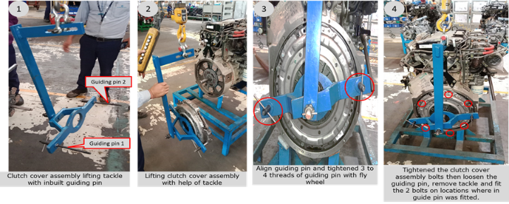
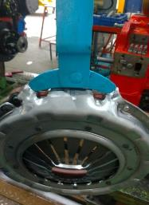
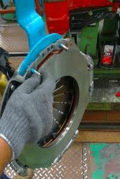
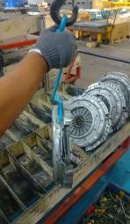
Cause verification - Assembly
395 dia clutch assembly mounting bolt breakage/ Flywheel spigot breakage
Following actions were implemented at both H2 & PNR plants to improve the assembly process
Guide pins to centralize the cover assembly inline with flywheel axis
Two point mounting lifting tackle to lift the cover assembly
PNR ->
H2 ->

Slide 23
Cause verification - Design
Competition Benchmark - MAV Tipper
MAV Tipper: 71% of competition MAV Tippers sold are with 430 mm dia clutch
Clutch size matrix
MAV Tippers | Clutch Dia | AL | TML | BB | VECV | MTBL
6x4 | 380 | 2820 | 2823
 | 395 | 2825 |  | 2823 /2828C |  | MN25
 | 430 |  | 2825/ 2830 | 2828 CH | Pro 6028 / 8028
8x4 | 380 | 3520 | 3523
 | 395 | 3525 |  |  |  | MN 35
 | 430 |  | 3525/ 3530 | 3528CH | Pro 8035
10x4 | 380 | 4220
 | 395
 | 430 |  | 4225
10x2 | 380 | 4220
 | 395 | 4825
 | 430 |  | 4225
10x4 DTLA | 395 | 4825
 | 430 |  | 4825
MAV Tippers | FY22 Sale Volume
 | TIV | AL | MS% | Competition | 430 Dia Volume (Est) | 430 dia SOB in competition
6x4 Tip | 21517 | 4906 | 23% | 16611 | 9967 | 60%
6x4 RMC | 6530 | 3082 | 47% | 3448 | 0 | 0%
8x2 Tip | 339 | 119 | 35% | 220 | 0 | 0%
8x4 Tip | 11264 | 2760 | 25% | 8504 | 8504 | 100%
10x2 Tip | 1551 | 209 | 14% | 1342 | 1342 | 100%
10x4 Tip | 490 | 139 | 28% | 351 | 351 | 100%
10x4 DTLA Tip | 6703 | 1522 | 23% | 5181 | 5181 | 100%
Tippers total | 54447 | 13917 | 26% | 35657 | 25317 | 71%
Data from Marketing

Slide 24
Cause verification - Design
Competition Benchmark - Tractor
Tractor Trailer: 87% of competition Tractors sold are with 430 mm dia clutch
Clutch size matrix
Tractors | Clutch Dia | AL | TML | BB | VECV | MTBL
40T | 380 | 4020 | 30.21/ 4018
 | 395 |  |  | 4020 | Pro 6040 | Blazo 40
 | 430 |  |  | 4028
46T | 380 | 4620
 | 395 |  |  |  |  | Blazao 46
 | 430 |  | 4625 | 5028 | Pro 6046
52-55T (4x2) | 380
 | 395 | 52-55T
 | 430 |  | 5530 | 5228 | Pro 6055
55T (6x4) | 395 | 5525 |  |  |  | Blazo 55
 | 430 |  | 5530 | 5528
Tractors | FY22 Sale Volume
 | TIV | AL | MS% | Competiton | 430 Dia Volume (Est) | 430 dia SOB in competition
40T | 3695 | 1021 | 28% | 2674 | 500 | 19%
46T | 3236 | 1345 | 42% | 1891 | 1600 | 85%
55T 4x2 | 12279 | 1979 | 16% | 10300 | 10300 | 100%
55T 6x4 | 10286 | 2335 | 23% | 7951 | 7500 | 94%
Tractor Total | 29496 | 6680 | 36% | 22816 | 19900 | 87%
Data from Marketing

Slide 25
Cause verification - Design
Competition Benchmark - MAV Haulage
MAV Haulage: 37% of competition MAV Haulage vehicles sold are with 430 mm dia clutch. 95% of Competition 10X2 DTLA Haulage are with 430mm dia clutch.
Clutch size matrix
MAV Haulage | Clutch Dia | AL | TML | BB | VECV | MTBL
6x2 / 6x2 DTLA | 380 | 2820 | 2818/2821 / 3118
 | 395 |  |  | 2823R | Pro 6028 | Blazo 28
 | 430
8x2 / 8x2 DTLA | 380 | 3520 | 3518/ 3521
 | 395 |  |  | 3523R | Pro 6035 / 6041 | Blazo 35
 | 430
10x2 | 380 | 4220 | 4221
 | 395 | 4225 | 4225 | 4228R |  | Blazo 42
 | 430 |  |  |  | Pro 6042
10x2 DTLA | 395 | 4825 |  | NA |  | Blazo 49 (12x2)
 | 430 |  | 4825 | NA | Pro 6048 / 8048
MAV Haulage | FY22 Sale Volume
 | TIV | AL | MS% | Competiton | 430 Dia Volume (Est) | 430 dia SOB in competition
6x2 | 13224 | 4896 | 37% | 8328 | 0 | 0%
8x2 | 7595 | 2971 | 39% | 4624 | 0 | 0%
10x2 | 14897 | 5704 | 38% | 9193 | 700 | 8%
10x2 DTLA | 19385 | 6267 | 32% | 13118 | 12500 | 95%
MAV Total | 55101 | 13917 | 36% | 35261 | 13200 | 37%
Data from Marketing

Slide 26
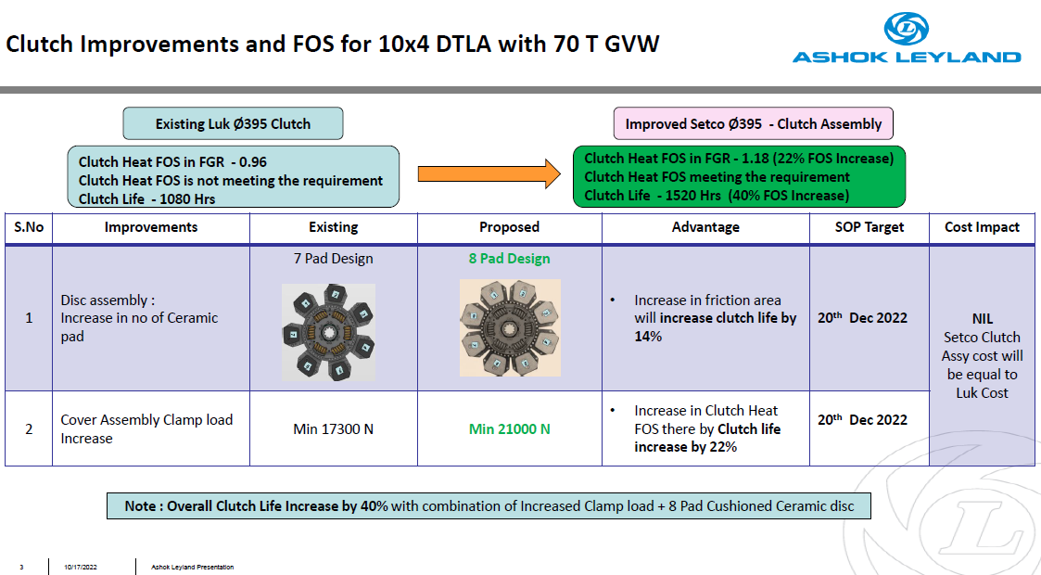
Cause verification - Design
FOS of 395 dia clutch in 10X4 DTLA Tipper

Slide 27
Benchmark info on Warranty handling
Clutch Burnt Cases | TML | BB
Warranty Practice for Clutch burnt cases | No Warranty | No Warranty (Warranty is provided based on Top Mgmt approval for one BS6 model recently due to some pickup/ gradeability issue. In General, warranty is not entertained for burnt cases. Even if the parts are received at Plant, it will be debited back to Dealer by quoting it as abuse)
Goodwill Practice | Sales Commercial – Area office budget Dealer Goodwill – Rs. 5 Lacs/Year/ Qualified Dealers for <6 Years old Vehicles (Utilization: 3.5L~4L) | Rs.1000 (or) 2000/Vehicle will be allocated under Goodwill budget based on sales volume of that period-will be fixed by the Organization. Ex: If Rs.1000/Vehicle is allocated by the Organization then the Dealer who sells 50 Vehicles can spend Rs.50,000 under Goodwill
Failed Part Receipts | 30% (or) 50% (or) 70% failed parts will be sent to respective Plants based on the claims selected by Quality team from Plant service office. Plant team will raise Dealer debit in case of any discrepancy. Service Engineer approval not required for raising debits Balance parts will be scraped at Dealership | Failed parts will be sent based on the requirement of Quality team. If the part is found failed due to abuse, the Quality team will reverse it to Dealer.

Slide 28
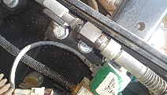
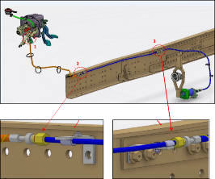
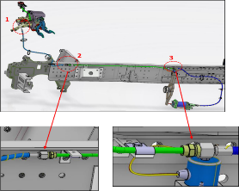
Cause verification – Clutch actuation
Clutch oil leak in hydraulic line
Complaint / Problem details |  | Clutch oil leak through push to fit connector joint (PR-ISS-005287) |  |  | Issue status | RL5
 |  |  |  |  | Issue grade | 4
Model |  | All MBP models
Mfg plant |  | H2/ PNR
Observation/ Root cause | Vehicle reported for the complaint of clutch pedal spongy/ oil leak from bundy pipe to hose connector (ptfc) Connector removed, O-rings observed in compressed condition Connector dimensions checked, no issue observed O ring deformation found PNR plant failure rate is high during Dec’20 to Oct’21 |  | Photos / Illustration | Illustration
 |  |  |  | v
Action | ER-DIN-0079982 implemented for metric thread design at both joints (2&3). C: Nov’21 PNR plant failure rate is high. The end fittings of Uniflex (PNR) make pipes are found with cleansing oil (Paraffinic) which is reactive with EPDM (O-ring material). Hence the cleansing process is established inline with Uniflex (Hosur-Uses Innoline 1999 Cleansing oil) . C: Nov’21
PTFC at Joint 2 & 3
Metric thread joint at Joint 2 & 3

Slide 29
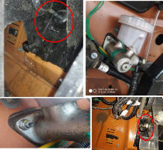
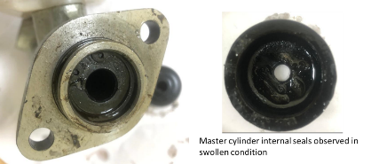
Cause verification – Clutch actuation
Clutch oil leak from Master cylinder
Complaint / Problem details |  | Clutch oil leak from Master cylinder (PR-ISS-003956) |  |  | Issue status | RL5
 |  |  |  |  | Issue grade | 4
Model |  | All MBP models
Mfg plant |  | H2/ PNR
Observation/ Root cause | Vehicle reported for the complaint of clutch pedal hard and oil leak from front side of Master cylinder Actuation system checked, no leak observed from the joints other than front end of the master cylinder Master cylinder seal found in swollen condition Seal will get swollen if the same is exposed to mineral oil/ mineral oil mix-up in clutch oil EPDM seals are not compatible with mineral oils & hence it was recommended clutch oil should not be contaminated & care to be taken Bundypipes are found with oil. While supplier audit (Uniflex – Rudrapur) observed that “Paraffinic Oil” (Mineral Oil) used by supplier for flushing. Residual oil remains inside pipe. This will get mixed with Clutch oil in vehicle and possibly result in contamination |  | Photos / Illustration | Illustration
 |  |  |  | v
Action | PNR plant failure rate is high. The end fittings of Uniflex (PNR) make pipes are found with cleansing oil (Paraffinic) which is reactive with EPDM (O-ring material). Hence the cleansing process is established inline with Uniflex (Hosur-Uses Innoline 1999 Cleansing oil) . C: Nov’21

Slide 30
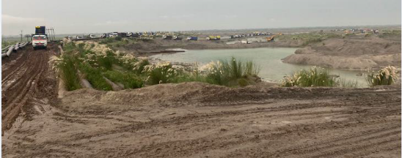
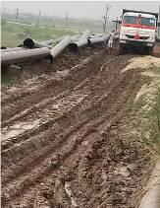
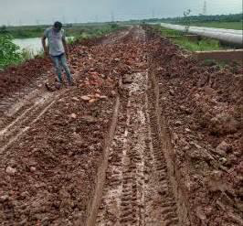
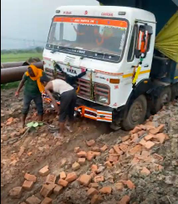
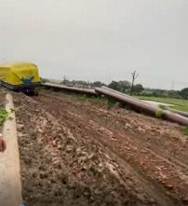
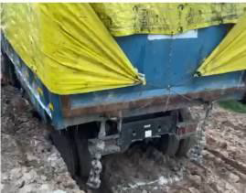
Cause verification – Application
Field study
Application: Fly ash
Lead distance: 100 kms
Loading point: Road condition near the loading site (4kms): Found off road with slippery pits. Frequent incidences of vehicle getting stuck in mud & subsequent wheel slip events observed.
Frequent wheel slip/ wheel lock observed in the site

Slide 31
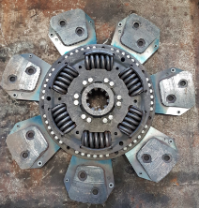
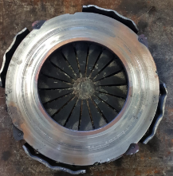
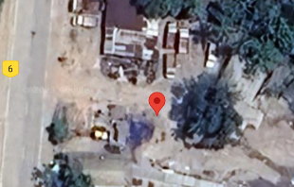
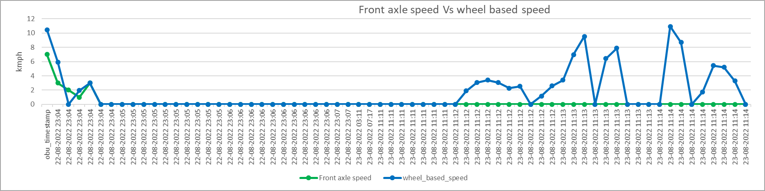
Clutch burnt – I alert data study
MB1XEVLD3NRMU3122
Chassis | MB1XEVLD3NRMU3122
Veh model | N 4825 10X4 DTLA 6600MM WB 29 CUM N4 2
DOS | 21-Feb-2022
DOF | 24-Aug-2033
Failed km/ hours | 490 hours
Location | Jagannath Vahan Pvt Ltd - Silchar
Complaint reported: Gear not engaging. Clutch burnt & Thermal cracks found in pressure plate
Wheel spin location
Wheel spinning observed

Slide 32
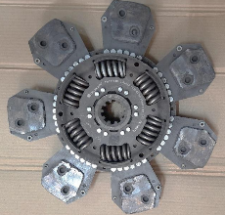
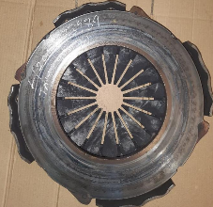
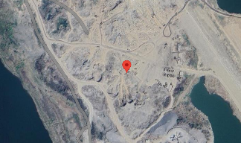
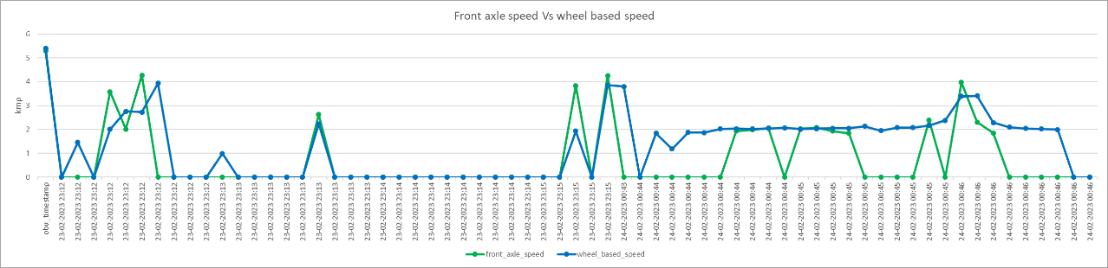
Clutch burnt
MB1JJVLD2NRPE3375
Chassis | MB1JJVLD2NRPE3375
Veh model | N3525T TSA 9SZF L4R2 R2 PBG ELC 22FET
DOS | 31-Dec-2022
DOF | 24-Feb-2023
Failed km/ hours | 427 hours
Location | AMPL-Rajahmundry
Complaint reported: Gear not engaging
Wheel spin & Clutch riding location
Wheel spinning observed

Slide 33
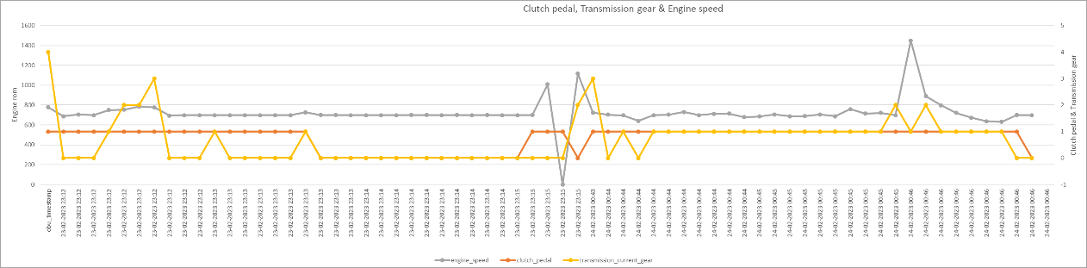
Clutch burnt
MB1JJVLD2NRPE3375
Clutch riding observed

Slide 34
Cause verification – Clutch burnt warranty handling
Benchmark info on Warranty handling
Clutch Burnt Cases | TML | BB
Warranty Practice for Clutch burnt cases | No Warranty | No Warranty (Warranty is provided based on Top Mgmt approval for one BS6 model recently due to some pickup/ gradeability issue. In General, warranty is not entertained for burnt cases. Even if the parts are received at Plant, it will be debited back to Dealer by quoting it as abuse)
Goodwill Practice | Sales Commercial – Area office budget Dealer Goodwill – Rs. 5 Lacs/Year/ Qualified Dealers for <6 Years old Vehicles (Utilization: 3.5L~4L) | Rs.1000 (or) 2000/Vehicle will be allocated under Goodwill budget based on sales volume of that period-will be fixed by the Organization. Ex: If Rs.1000/Vehicle is allocated by the Organization then the Dealer who sells 50 Vehicles can spend Rs.50,000 under Goodwill
Failed Part Receipts | 30% (or) 50% (or) 70% failed parts will be sent to respective Plants based on the claims selected by Quality team from Plant service office. Plant team will raise Dealer debit in case of any discrepancy. Service Engineer approval not required for raising debits Balance parts will be scraped at Dealership | Failed parts will be sent based on the requirement of Quality team. If the part is found failed due to abuse, the Quality team will reverse it to Dealer.

